Slide 1
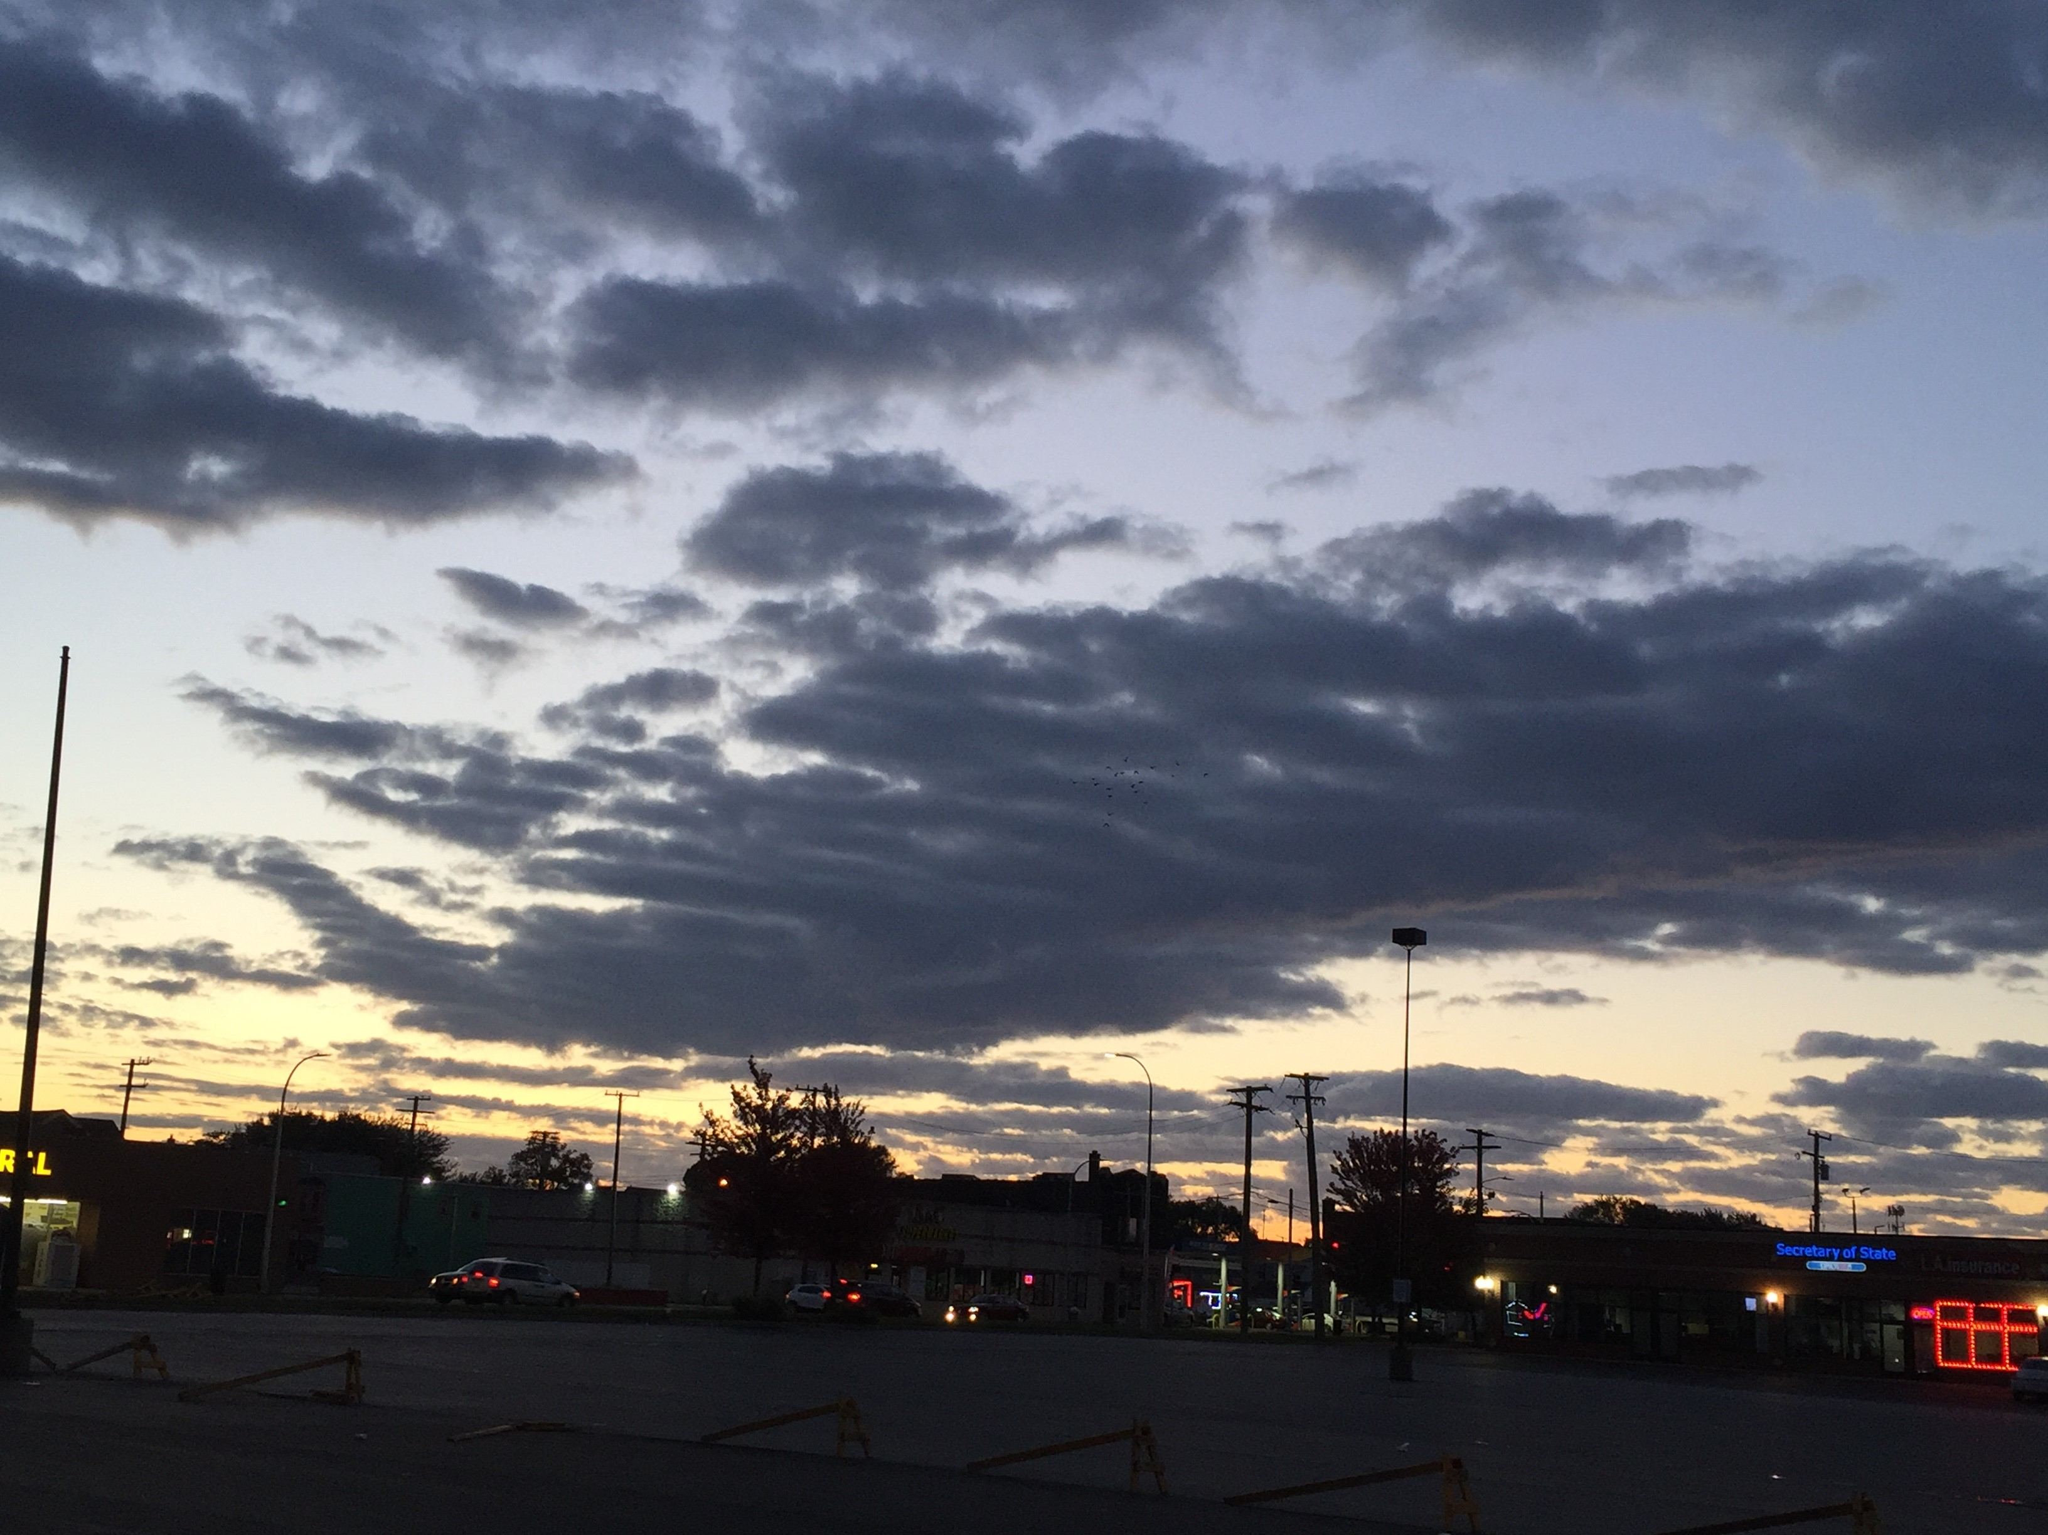
Tuesday, October 23, 2018
Hello ☺

Slide 2
Grammar – Show Us What You Know – Use the correct form of the verb
If I _________ right now, I __________ on time. (leave, be)
They responded by _______________ dinner for the tired, young parents. (make)
He likes _____________ his bike to work. (ride)

Slide 3
Grammar – Part II
You ___________ well if you _____________ today. (sleep, exercise)
She injured her leg while _________________ (skateboard).
They ________ already __________ the store when mom _________ them with a few more items ____________. (left. text, buy)

Slide 4
Context Clues
Review – what types are there?
Article about the governor of Michigan.

Slide 5
Ms Silva
Monday, October 29, 2018
A reading test, only
Concerns about attendance for winter.
Notes:
Options – practice lesson today. Practice test tomorrow

Slide 6
Motivation
What is motivation?
Listening activity – page 15.
Notes:
Write directly on the handout from last week.

Slide 7
What do you do?
Exercise E – page 16 in the Standout book.

Slide 8
End of the first unit
Learning styles
Multiple intelligences
Goals
Motivation
Earning power
Educational attainment
Notes:
One more grammar lesson, we’ll start tomorrow

Slide 9
Your Task
Create a poster about YOU.
Include your goals, your motivation, learning styles, intelligences, a job that interests you, and a picture of you (I’ll take and print).
You may include other images that are important to you.
Won’t finish today. Probably.

Slide 10
Exit Tickets Before We Leave
How old must a candidate be to run for governor of Michigan?
What is the longest someone can be governor?
What does it mean to grant a pardon?

