Slide 1
Thursday, November 1, 2018
Happy New Month

Slide 2
On Sunday
Before you go to bed on Saturday night, move your clocks one hour back.
Fall back.

Slide 3
Test Feedback
Paragraphs seemed to be difficult for many people.
Context clues and knowing the structure of a short article.
Clues we can use: word parts (prefixes, suffixes, roots), synonyms, antonyms, definitions (within the sentence or paragraph), examples, cognates, and punctuation.
Notes:
Distribute packet with word parts and greek and latin word parts. Also, do some synonyms and antonyms.

Slide 4
How paragraphs are written
Topic sentence – first sentence (usually).
Tells us what the topic of the paragraph is.
Practice

Slide 5
Sample paragraph 1
Ants are fascinating creatures. They are found everywhere in the world. They make their home in buildings, gardens etc. They live in anthills. Ants are very hardworking insects. Throughout the summers they collect food for the winter season. Whenever they find a sweet lying on the floor they stick to the sweet and carry it to their home. Thus, in this way, they clean the floor. Ants are generally red and black in color. They have two eyes and six legs. They are social insects. They live in groups or colonies. Most ants are scavengers they collect whatever food they can find. They are usually wingless but they develop wings when they reproduce. Their bites are quite painful.

Slide 6
Sample paragraph 2
The elephant is an amazing animal. It is the largest living animal on land. It is quite huge in size. Elephants have four legs, a long trunk and two white tusks near their trunk. Apart from this, they have two big ears and a short tail. They are usually black or grey in color. Elephants are vegetarian. They eat all kinds of plants especially bananas. They are quite social, intelligent and useful animals. They are used to carry logs of wood from one place to another. They are good swimmers.

Slide 7
Sample paragraph 3
My dog Romeo is so much fun to play with. One reason he’s fun is because he loves to play catch. What’s also fun is that he follows me around the house with a toy and drops it on my foot, hoping I will kick it. Additionally, he can catch just about anything, but his favorite thing to catch is a Frisbee. Finally, he loves it when I pretend to be dead. After I fall, he runs over to lick me. All these reasons are why I really have fun playing with Romeo.

Slide 8
Sample paragraph 4
People do it everyday. They log on to their favorite website and browse for hours, checking out bargains. They dump every possible wish into their shopping carts, knowing they can cast each one aside before they finalize their purchases. On the way, they may enter a sweepstakes in the hopes of winning a trip to Cabo San Lucas, or maybe even a new SUV. And then, when they have decided on their purchases, they enter private information without giving it a thought. With a keystroke, they release their personal data into what may or may not be a secure zone. Despite what much of the public believes, internet shopping is not safe.

Slide 9
Sample paragraph 5
When a camera flash is used in a low-light environment, the subject's eyes may appear red in the photograph. What is known as "red-eye" is the result of light from the flash reflecting off the pupils of the eyes. The phenomenon of red-eye can be lessened by using the red-eye reduction feature found on traditional cameras. This feature activates a lamp which shines a small light directly into the subject's eyes. When this happens, the diameter of the pupil is reduced, thus closing the opening in the iris. Since a smaller pupil means a smaller spot for the reflection, the chances of red-eye occurring are greatly reduced.

Slide 10
More than one paragraph
Introduction paragraph – tells us the main idea of the entire piece.
Often found at the end of the first paragraph, but not always.
Burlington in-class lesson.

Slide 11
From the worksheet
No one likes to eat with a dirty knife, fork, or spoon.
It is important to completely wash all utensils before using them.
Clean utensils won’t transmit germs and bacteria.
They are also more pleasant to eat with.

Slide 12
Article to practice
Let’s identify the sentence in the first paragraph that identifies the main idea of the entire article.
Let’s identify the topic sentences in each paragraph.
Notes:
Read only the first sentences

Slide 13
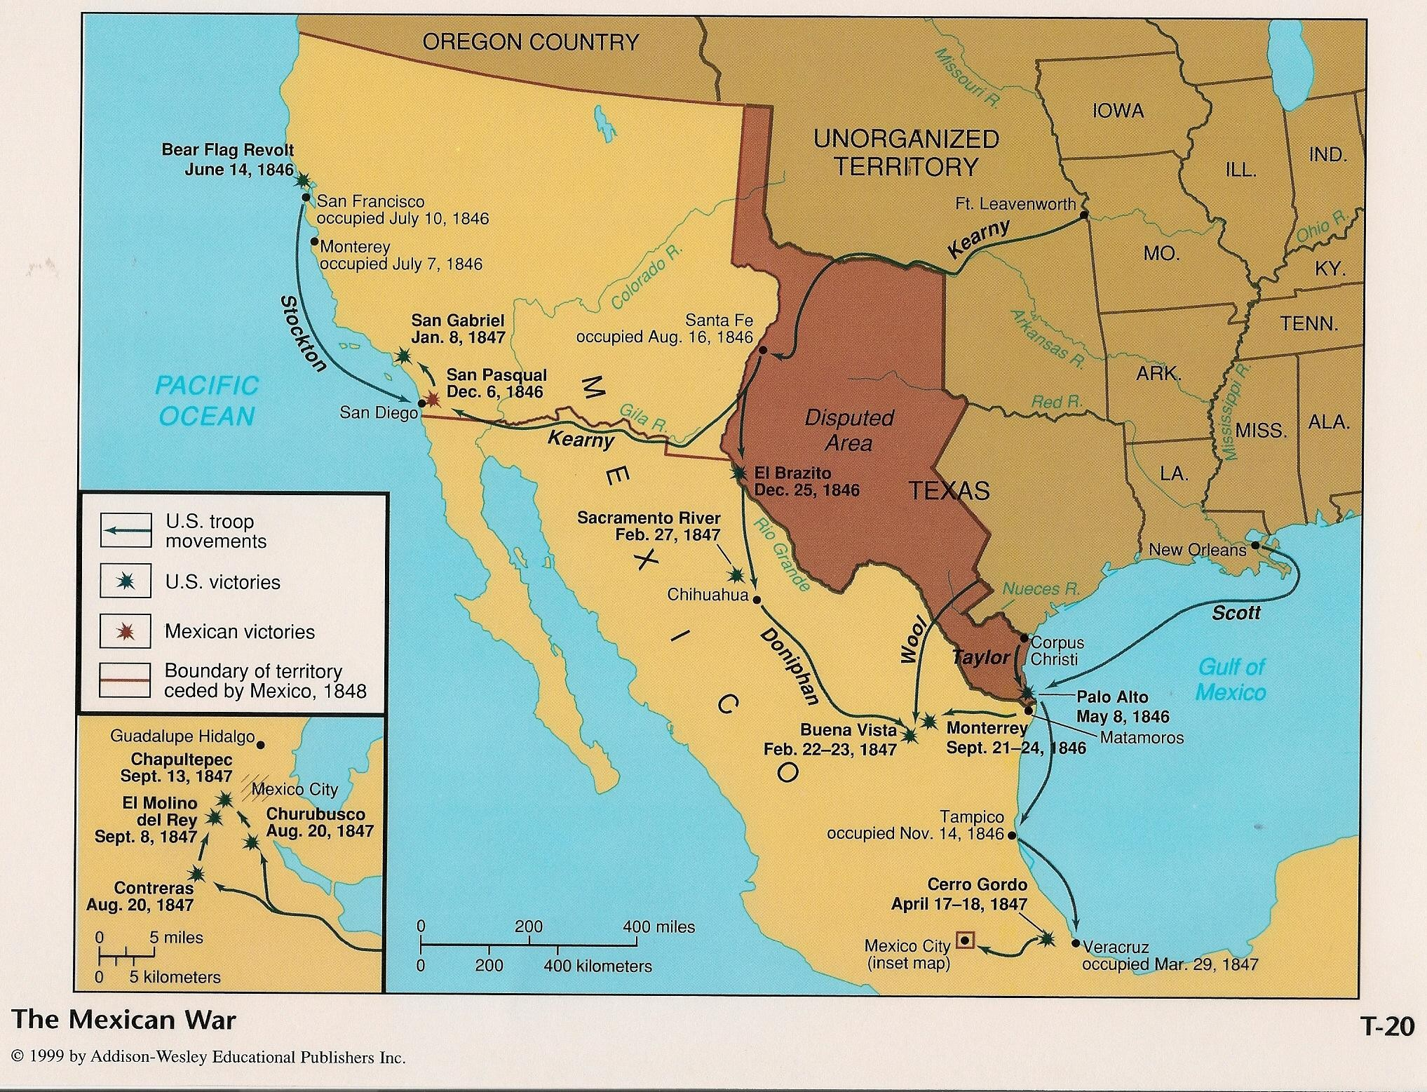
Why read about the Day of the Dead?

Slide 14
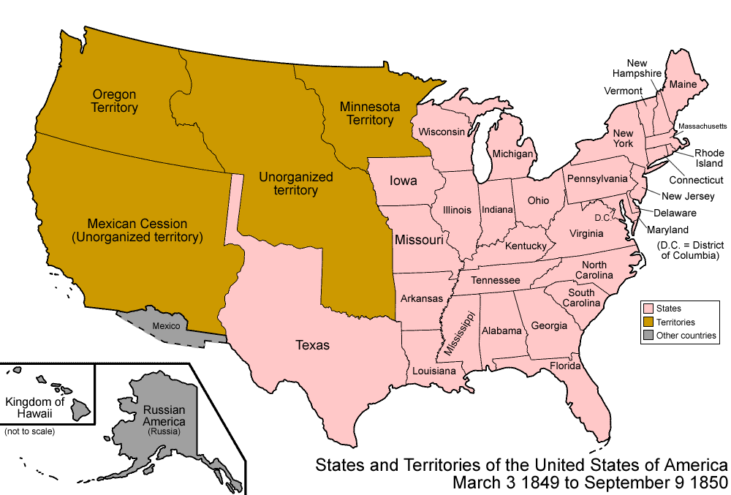
After the Mexican-American War

Slide 15
Burlington Individual Practice
Burlington listening “test” next Thursday, November 8
Many ways to practice listening on Burlington: “test,” lessons in other online books.
We will work on the profile on Monday.

