Slide 1
Wednesday, November 28, 2018

Slide 2

Announcements
Hiring event/job fair – tomorrow (flyer)
Dates for upcoming break
  Dec. 24 – Jan. 1
  Class resumes on January 2
Free event in Hamtramck tomorrow – Winter Glow

Slide 3
Verbs – read carefully and determine which tense is needed in each sentence
We enjoy ___________________(watch) movies every Saturday night.
They plan ____________________ (pay) off their highest interest credit card by the end of the year.
He __________________(save) $5,000 by the time he is 35.

Slide 4
Verbs – read carefully and determine which tense is needed in each sentence
If she _______________(start) making her coffee at home, she _______________(save) $20 a week.
The store ___________________ (sell) the popular toy since last week when it sold out yesterday.

Slide 5
Past perfect continuous
You ______________ (wait) there for more than two hours when she finally arrived.
Mike wanted to sit down because he __________________ (stand) all day at work.
Lily _________________ (study – negative) Spanish very long before she was speaking very well.

Slide 6
Too, Too Much, Too Many
Too much cold - ??? – not quite
It’s too cold outside today.
Too + adjective
She’s too angry to speak.
I’m too sick to go to work today.

Slide 7
Too, Too Much, Too Many
Too much + noncount noun
Noncount noun – a noun you can’t count and cannot make plural
Examples: water, sugar, snow, debt. anger
I poured too much water in the glass.
He put too much sugar in his tea.
They have too much debt and need to save more money.
She’s feeling too much anger right now to think clearly.

Slide 8
Too, Too Much, Too Many
Too many + count nouns
Count noun – a noun you can count and make plural
Examples: child, pen, car, bill
There are too many children in that class.
I found too many pens in the bottom of my purse.
The parking lot has too many cars today.
We have too many bills to pay.

Slide 9
Too, Too Much, Too Many
The store has ________________ types of soup. It’s hard to choose.
___________________ snow falls in the winter. I hate snow.
He is ________________ young to watch that movie.
She had ________________ pain in her knees to go ice skating last weekend.
Is it possible to get _________________ sleep?
I have ______________________ chores to complete at home tonight.
That designer purse is __________________ expensive for me to buy.

Slide 10
Reduce debt and save money – lesson 2 (PM class)
What does budget cut mean?
Page 29 – Tips For Saving Money “web page”
Listening activity

Slide 11
Vocabulary
What is a convenience store?
What does carpool mean?
What does it mean to clip coupons?
What is a deductible?

Slide 12
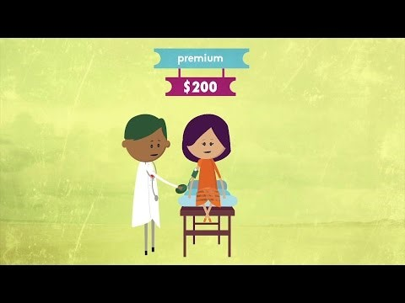
Deductible – explained
Here’s a little video that explains what a deductible is

Slide 13
Calculating Interest
Math ☺
APR – Annual Percentage Rate
Credit card interest is calculated daily.
APR divided by 365 = daily rate
Daily rate x daily balance
A few problems together

Slide 14
Eric’s Story – He needs furniture, but…
Read Eric’s story alone.
Identify difficult or confusing vocabulary.
Read together
Comprehension questions
What should he do?

Slide 15
Exit card
Write a sentence about your life using the past perfect continuous.
Example: I had been living in Ferndale before I moved to Windsor.

