Slide 1

Wednesday, November 7, 2018
Happy Middle of the week.

Slide 2
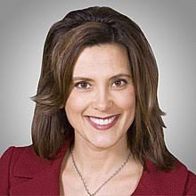
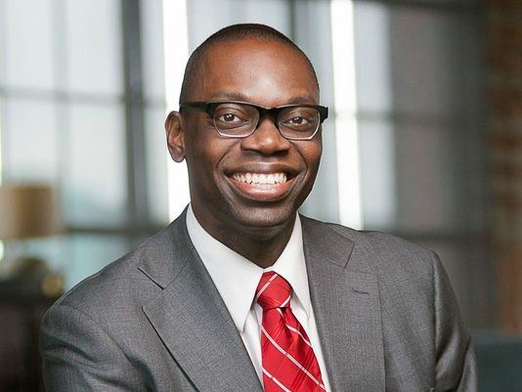
Election Results
New Michigan governor – Gretchen Whitmer
New Michigan Lieutenant Governor – Garlin Gilchrist
All three ballot proposals passed.
State House and Senate – Republicans retain control
U.S. House of Representative – new Democratic majority
U.S. Senate – Republicans retain control

Slide 3
Practice the verbs
Who ___________ ___________ to the movies tonight?
The confused bird _________ into my kitchen window.
If I __________ her, I ______________ hello.
Notes:
Want, go
Want, go , fly, see, say

Slide 4
Future Perfect
What is it?
How does it work?
Two future events. The first future event – will have + participle.

Slide 5
Future Perfect Tense
I will have become a teacher by the time my kids are in school.
He will have been a graphic designer for five years when he turns 35.
They will have found a job by 2019.

Slide 6
Future Perfect
By the time I graduate from college, I _____________________ (do) 200 hours of community service.
I ____________________ (buy) a new car before the school year starts.
When I turn 60, I __________________ (attend) more than 300 concerts.

Slide 7
Future Tense
We ___________________ (swim) 20 laps by the time the pool closes.
She ___________________(talk) with her mom by the time her dad gets home.
When the dog finishes his meal, Bubba ________________________ (wash) all the dishes.

Slide 8
Unit 2 – Personal Finance - goals
Organize your finances
Reduce debt and save money
Identify investment strategies
Maintain good credit
Protect yourself against identity theft
Notes:
What do these terms mean?

Slide 9
Unit 2 – Personal Finance – Vocabulary Builder
Listen to the recording (made by a friend ☺)
Listen for the phrases that are on the sheet. Circle the ones you hear. Not all will be used.
Listen a second time. See if you can write one sentence – dictation.
Notes:
Don’t worry about spelling for the dictation

Slide 10
Unit 2 – personal Finance – vocabulary builder
Look at handout. Need volunteers to read.
Definitions – many idioms
Three teams – define the assigned words. Find sample sentences. Posters to help us remember. What are some visuals that might help us? Add those to the posters.

Slide 11
Unit 2 – Personal Finances – Vocabulary
More vocabulary on the back
Use context clues.

Slide 12
Tomorrow
A little grammar practice.
Topic sentences
Practice listening test on Burlington

