Slide 1
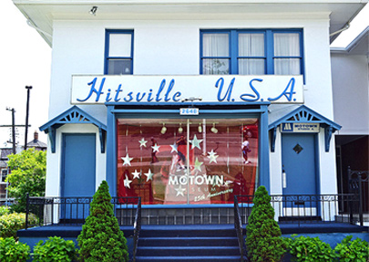
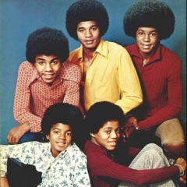
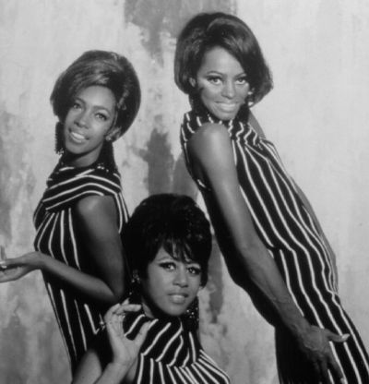
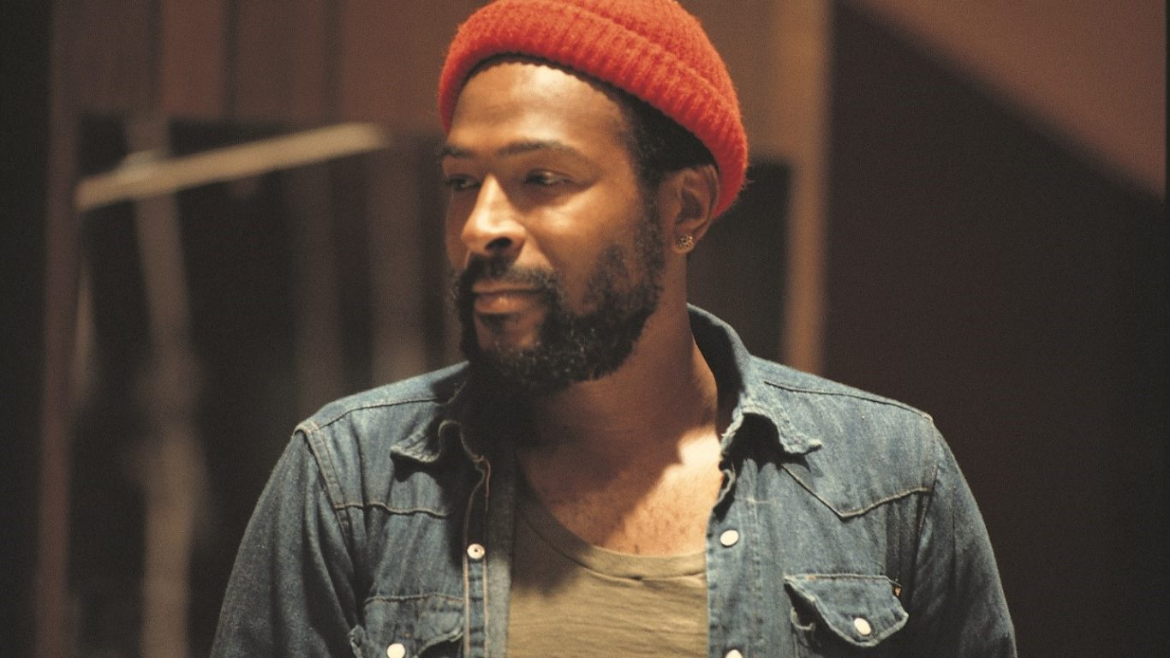
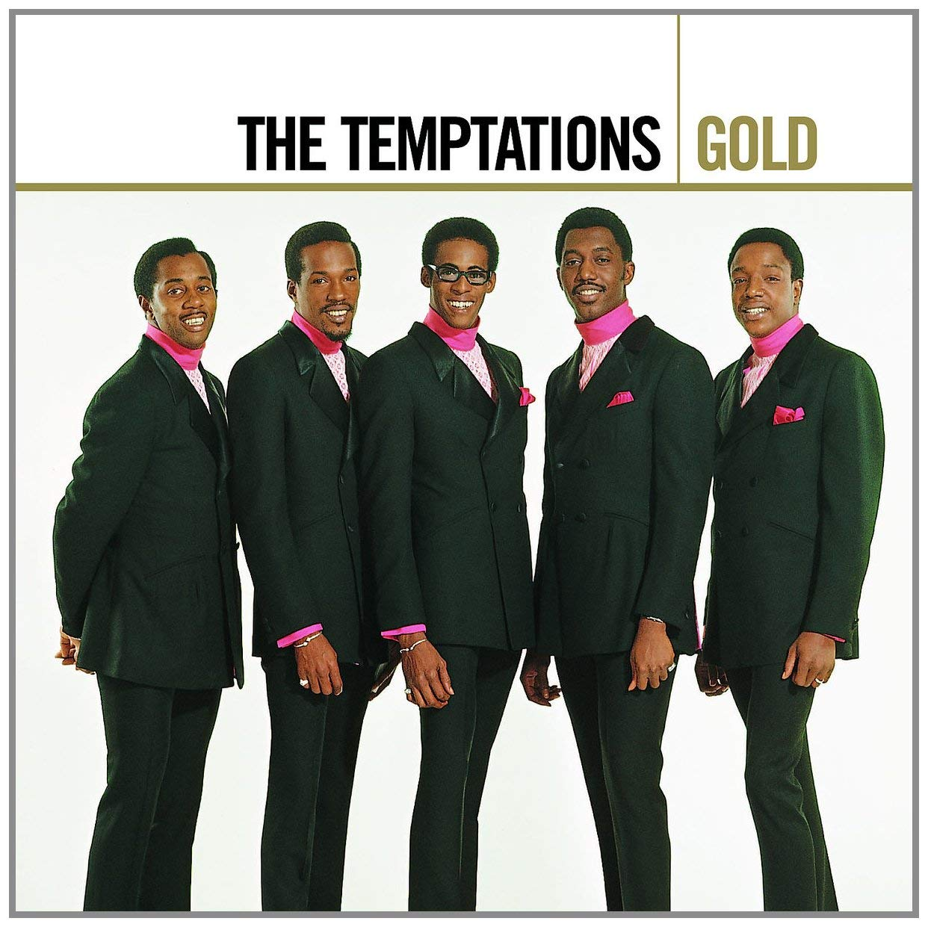
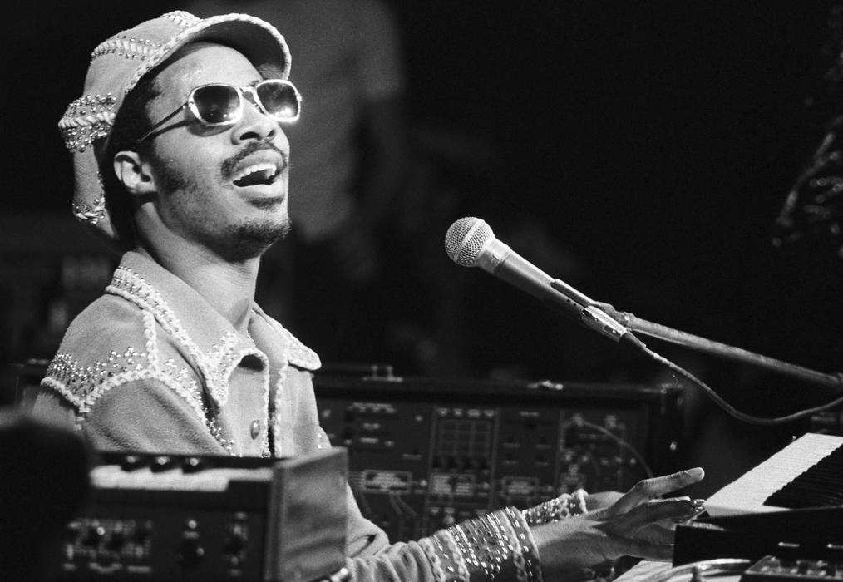
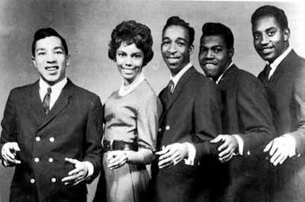
History of Michigan - Motown

Slide 2
Thursday, December 6, 2018

Slide 3
Announcements and free event
Burlington “tests” on December 19 and 20.
Free event at the Hamtramck Public Library – December 11 and 18
  Free family movie at 4:00 p.m. at the Hamtramck Public Library

Slide 4
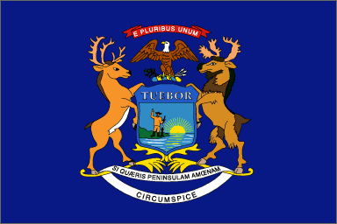
History of Michigan

Slide 5
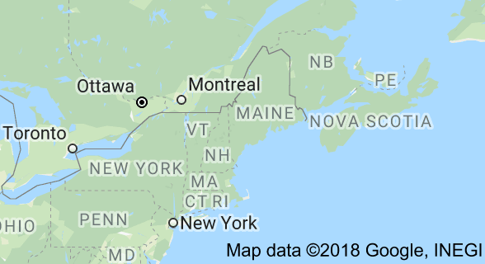
History of Michigan - vocabulary
Peninsula – a body of land surrounded by water on three sides.
Furs – animal skins/pellets with hair still attached
New England – a region of the U.S. on the East Coast that includes: Connecticut, Maine, Massachusetts, New Hampshire, Rhode Island, and Vermont

Slide 6
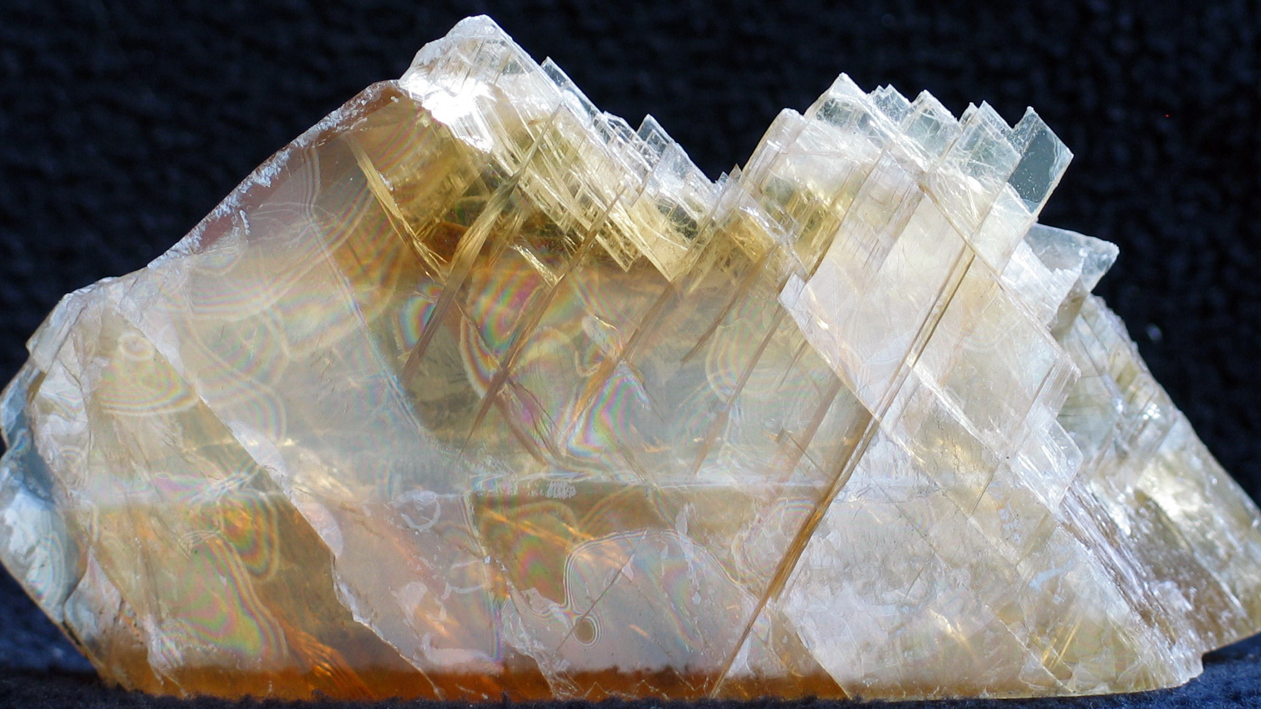
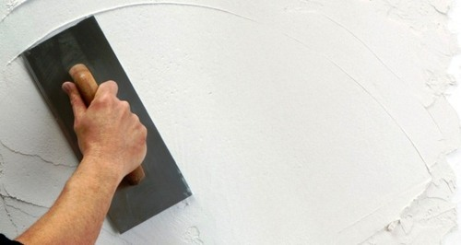
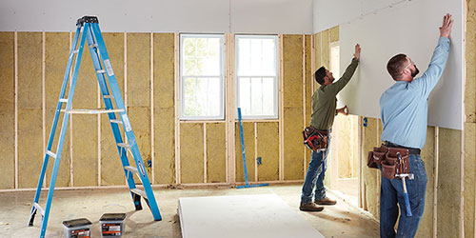
History of Michigan - vocabulary
Resource-rich – many natural resources available
Gypsum – soft mineral often used to make fertilizer, plaster, blackboard chalk, and wallboard/drywall

Slide 7
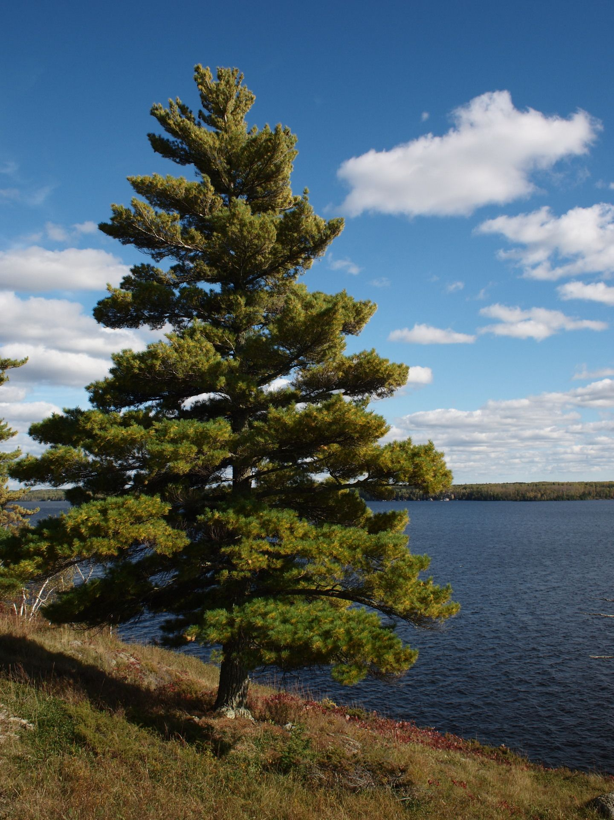
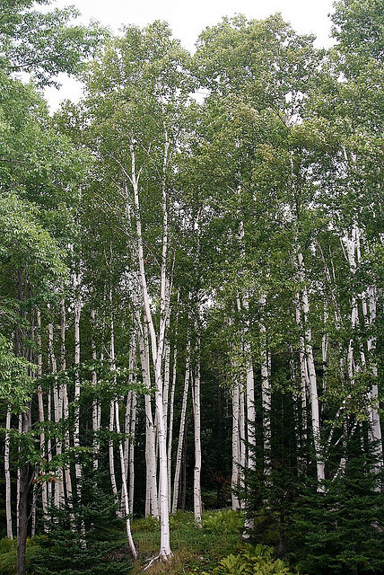
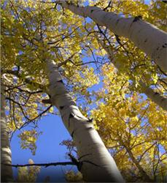
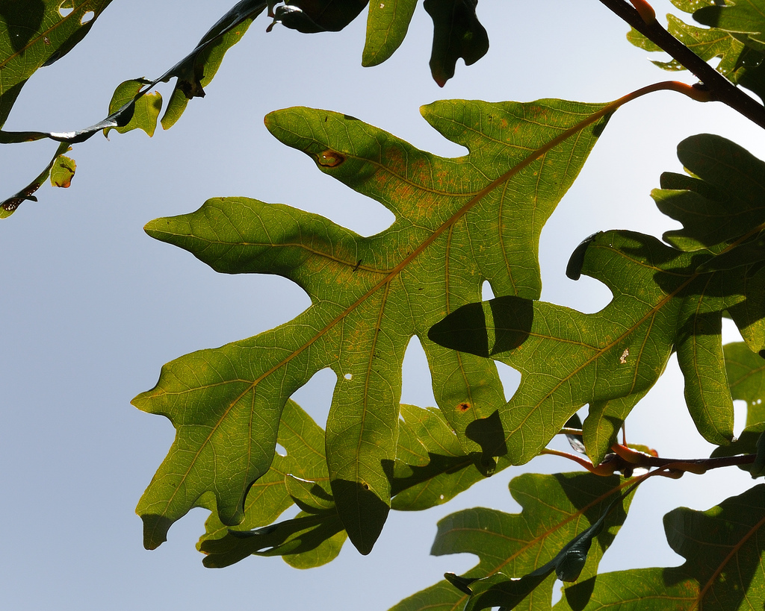
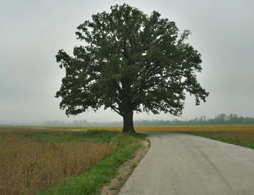
History of Michigan - vocabulary
White pine
Birch
Aspen
Oak

Slide 8
Modal of ability
can or could or am able
I can read that book.
We could eat early, if we have to go to the store.
She is able to drive a stick shift.
He could climb tall trees when he was a kid.
Notes:
Write two sentences that describe some you can do now and something you could do in the past.

Slide 9
Modals – ability – sentences from yesterday – AM class
I could go to the gym twice a week.
I can driving
I can walk 3 mile on day.
I could not attend some classes.

Slide 10
Modals - ability
She ________________ learn to play chess if she tried.
He _________________ speak four languages.
You ________________ have bought a nice car if you had saved more money.
The cat ______________ leap very high in the air.
Notes:
Which fits best – can or could? 1. could 2. can

Slide 11
Burlington
Resume in-class lesson

