Slide 1
Monday, March 4, 2019

Slide 2
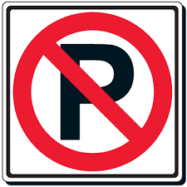
Name the traffic sign

Slide 3

Name the traffic sign

Slide 4
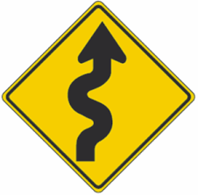
Name the traffic sign

Slide 5

Name the traffic sign

Slide 6
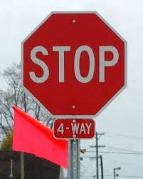
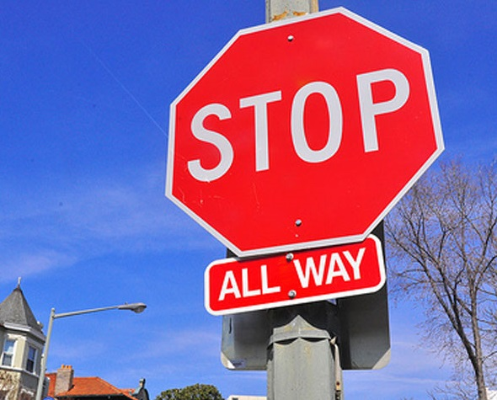
Name the traffic sign

Slide 7
Safety features
New cars have new safety features.
Eventually most cars will have most of these features.
List from Consumer Reports

Slide 8
Distracted driving
What is distracted driving?
Document from the state of Michigan about distracted driving.

Slide 9
Question words
Name all the question words. Explain when we use them?
Put together the words in the correct order to form a question.
  There are no capital letters, so that part of the sentence will be incorrect.

Slide 10
Correct answer for your question
About 230.
About 35,000.
About 19.
About $60.
About 15 cents.
16 gallons.

Slide 11
Your turn to create information questions
Using one of the articles we read today, create three information questions. Each question must start with one of the question words. Work with a partner.
Who
What
When
Where
Why
Which
How

Slide 12
Your questions

