Slide 1
Thursday, February 28, 2019

Slide 2
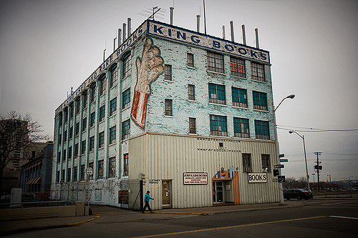
Free in Detroit
John King Books
  1,000,000 used books in stock.
  Four floors.
  Books are not free, but browsing is free.
Free citizenship classes
  Tuesday at 5:00 p.m.
  Hamtramck Public Library

Slide 3
Sentences from yesterday
Houses in Yemen are usually big and tall housess.
Teenagers in the U.S. usually have cars at the age of 16.
Food in the U.S. usually have a nonorganic elements.
Television programs in the U.S. often full of ads.
Notes:
Are these correct?

Slide 4
Name these signs
Match the street sign to the correct name.
Two teams.
GO!
Page 59 – exercise B

Slide 5
Forming questions
Question words?
Information wanted with each question word?
When?
Where?
Who?
What?
Why?
How? *****
Notes:
How is often followed by words like much, many often, etc.

Slide 6
Forming Questions
This summer, my friends and I are planning to go camping for a week in the Upper Peninsula (UP).
The kids went to a birthday party last week and ate too much cake.
She got a flat tire yesterday on I-75 in the middle of rush hour traffic.
Notes:
Each sentence offers different possibilities for asking questions? How many questions can we form with each sentence?

Slide 7
Interview Questions
Pretend you are a journalist.
You can interview anyone you want.
Who do you interview?
Create 10 questions you would ask that person?
Notes:
Famous, not famous. Dead or living. It doesn’t matter who.

