Slide 1
Tuesday, March 5, 2019
Fat Tuesday!! Go get a Paczki!!

Slide 2

Name this Traffic sign

Slide 3

Name this traffic sign

Slide 4

Name this traffic sign

Slide 5
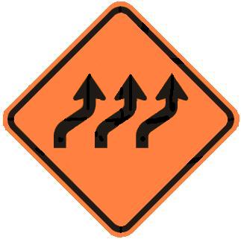
Name this road sign

Slide 6
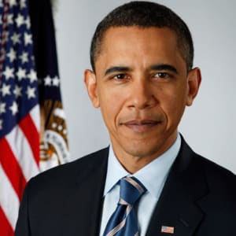
What would you ask this person
Information questions only

Slide 7
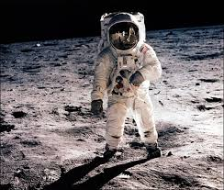
What would you ask this person
Information Questions only
Neil Armstrong – first human to walk on the moon.

Slide 8
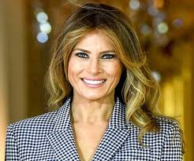
What would you ask this person
Information questions only.

Slide 9
You are a journalist
You have a chance to interview anyone. Dead or alive. Famous or Not.
What five information questions would you ask that person?
Write and turn in.

Slide 10
Distracted Driving Article
What was the percentage increase in road fatalities between 2012 and 2016?
What is dopamine?
What are some reasons people gave for using their phone while driving?
Who is Mitchel Kiefer?
When is distracted Driving awareness month?
How much is the fine for texting and driving in Alaska?
According to state farm, how much will insurance increase after a ticket for distracted driving?
When was this article written?

