Slide 1
Wednesday, March 6, 2019

Slide 2

What is this sign?

Slide 3

What is this sign?

Slide 4
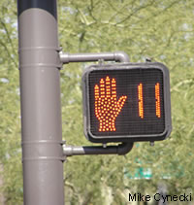
What is this called?

Slide 5
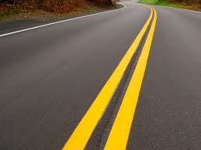
What happens when you see this?

Slide 6

What does this mean?
Notes:
No parking. Commercial unloading is fine.

Slide 7
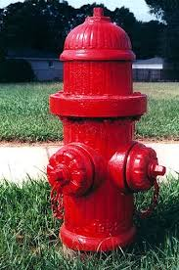
Can you park here?

Slide 8
Your “interview” questions
Which place do you like to visit? (Obama)
When will you start teaching in Hamtramck? (me)
When did you marry with Trump? (Melania Trump)
How much money do you spend every year for removing poverty? (Bill Gates)

Slide 9
Reading tables with statistics
Tables consist of:
  rows and columns
  headings
  statistics (usually)

Slide 10
Crash types
How many columns?
How many rows (not including the headings)?
What are the headings for each column?
Tell me about:
  Michigan
  New York
  Wyoming
  Florida
  Oregon
  Arkansas

