Slide 1
Welcome!
Monday, September 9, 2019

Slide 2
Classroom Space
Rented property
Try not to drag chairs and tables along the floor.
Bathroom – location
Locked doors
Emergency exits
Let’s keep it as neat and clean as possible.
  Garbage pail locations
  Boxes for recycling

Slide 3
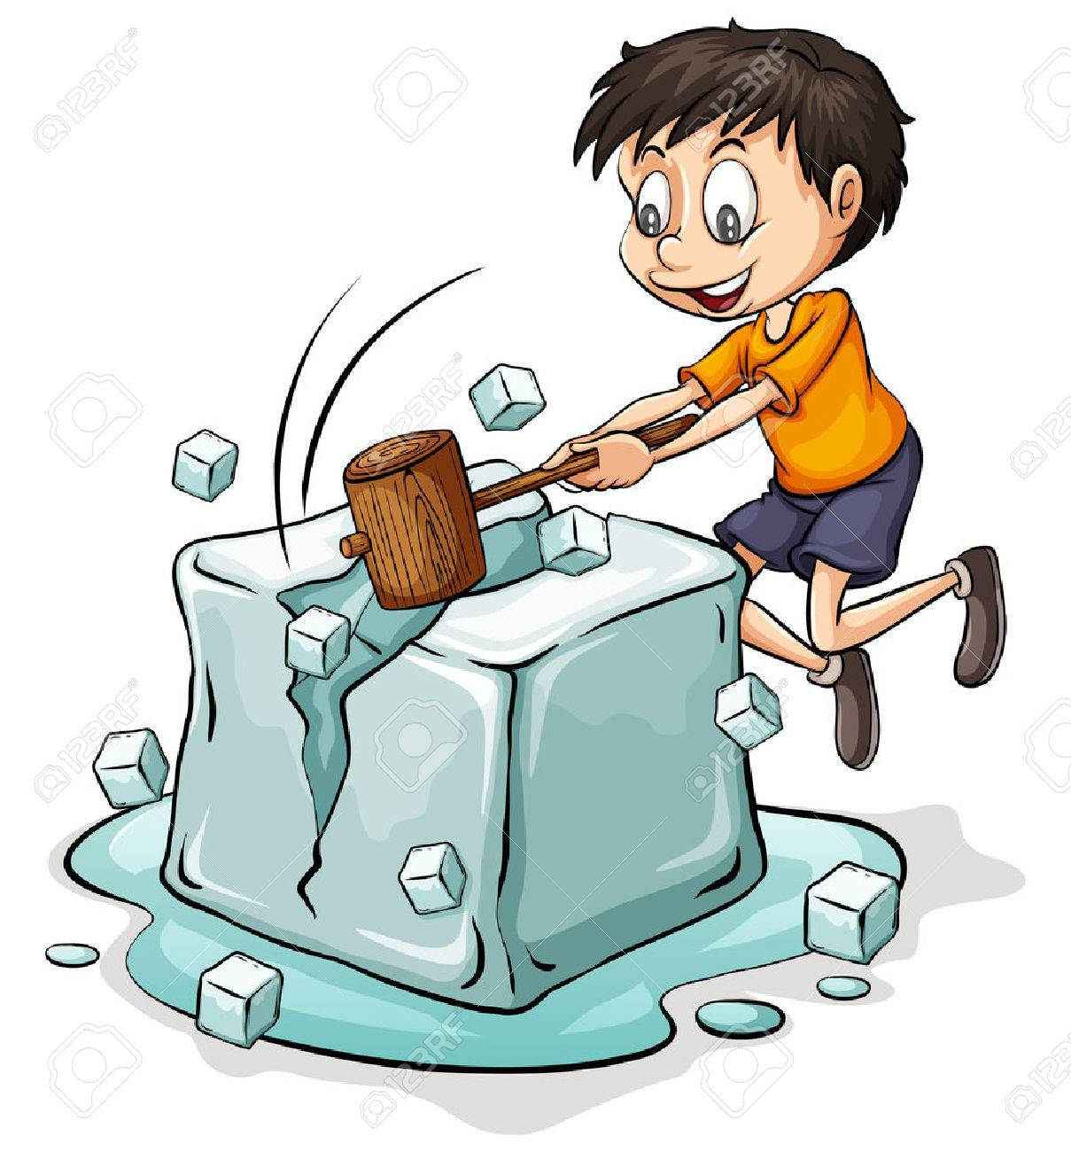

Icebreaker
Icebreaker is an activity that helps people to get to know each other. The word is an idiom
Take a few post-it notes and place on table in front of you, separately.

Slide 4

Ice Breaker
On each post-it note, write one fact about yourself.
If you have five post-it notes, you will write five different facts.
Notes:
Model for class with my own facts and post-its. I’ll take five notes.

Slide 5
Share!!

Slide 6
Class Structure
Monday - Textbook and grammar
Tuesday – Textbook and grammar
Wednesday – Textbook and grammar
Thursday – Reading (US history, civics, and your interests) and computers (starting in October)

Slide 7
Community Standards
With your table – brainstorm ideas for “rules” we should have to help everyone learn in a positive environment.
5 minutes
Share.

Slide 8
Survey - Interests
One page only. Spelling doesn’t count.
Helps me know a little bit about you.
Repeat after me as I read.
Any individuals want to read aloud? A few volunteers needed.

Slide 9
Jenga
Pull out a block.
Look at the number.
Answer the question on the index card with that number.
Can we keep the tower standing?

Slide 10
Tomorrow
Back here at 9:00.
Bring a notebook for taking notes.
A pen or pencil.
Perhaps a folder for keeping worksheets.
What are different things we say when we are leaving a place?

