Slide 1
Thursday, September 26, 2019
The end of the week

Slide 2
Conversation Class
Starting Friday, October 4, 2019
10225 Jos. Campau
9:00 a.m. – 11:00 a.m. – Advanced Conversation
11:00 – 1:00 p.m. – Intermediate Conversation

Slide 3
Free in Detroit
Cider in the City at Beacon Park.
Every Saturday from 1 – 5 until October 26
● Donuts and Cider
● Fall farm stand
● Weekly themed activities
● Make and Takes (crafts)
● Lawn games – cornhole, jenga, foosball, connect four, and fowling
● Food trucks
● Inflatables
It will be delicious!

Slide 4
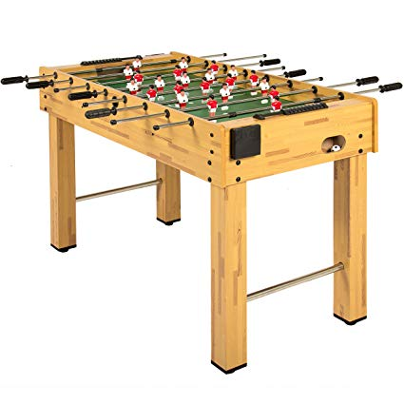
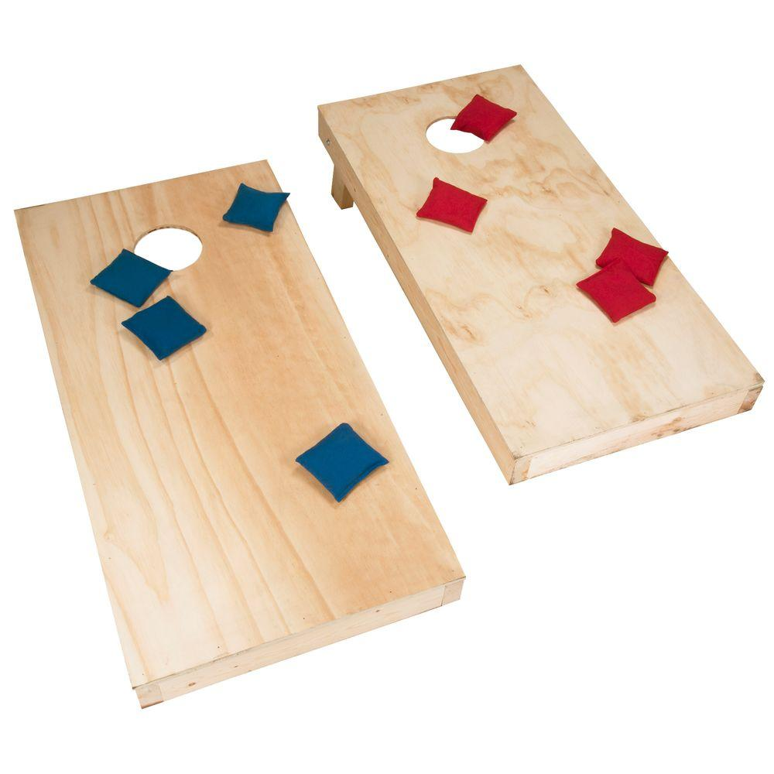
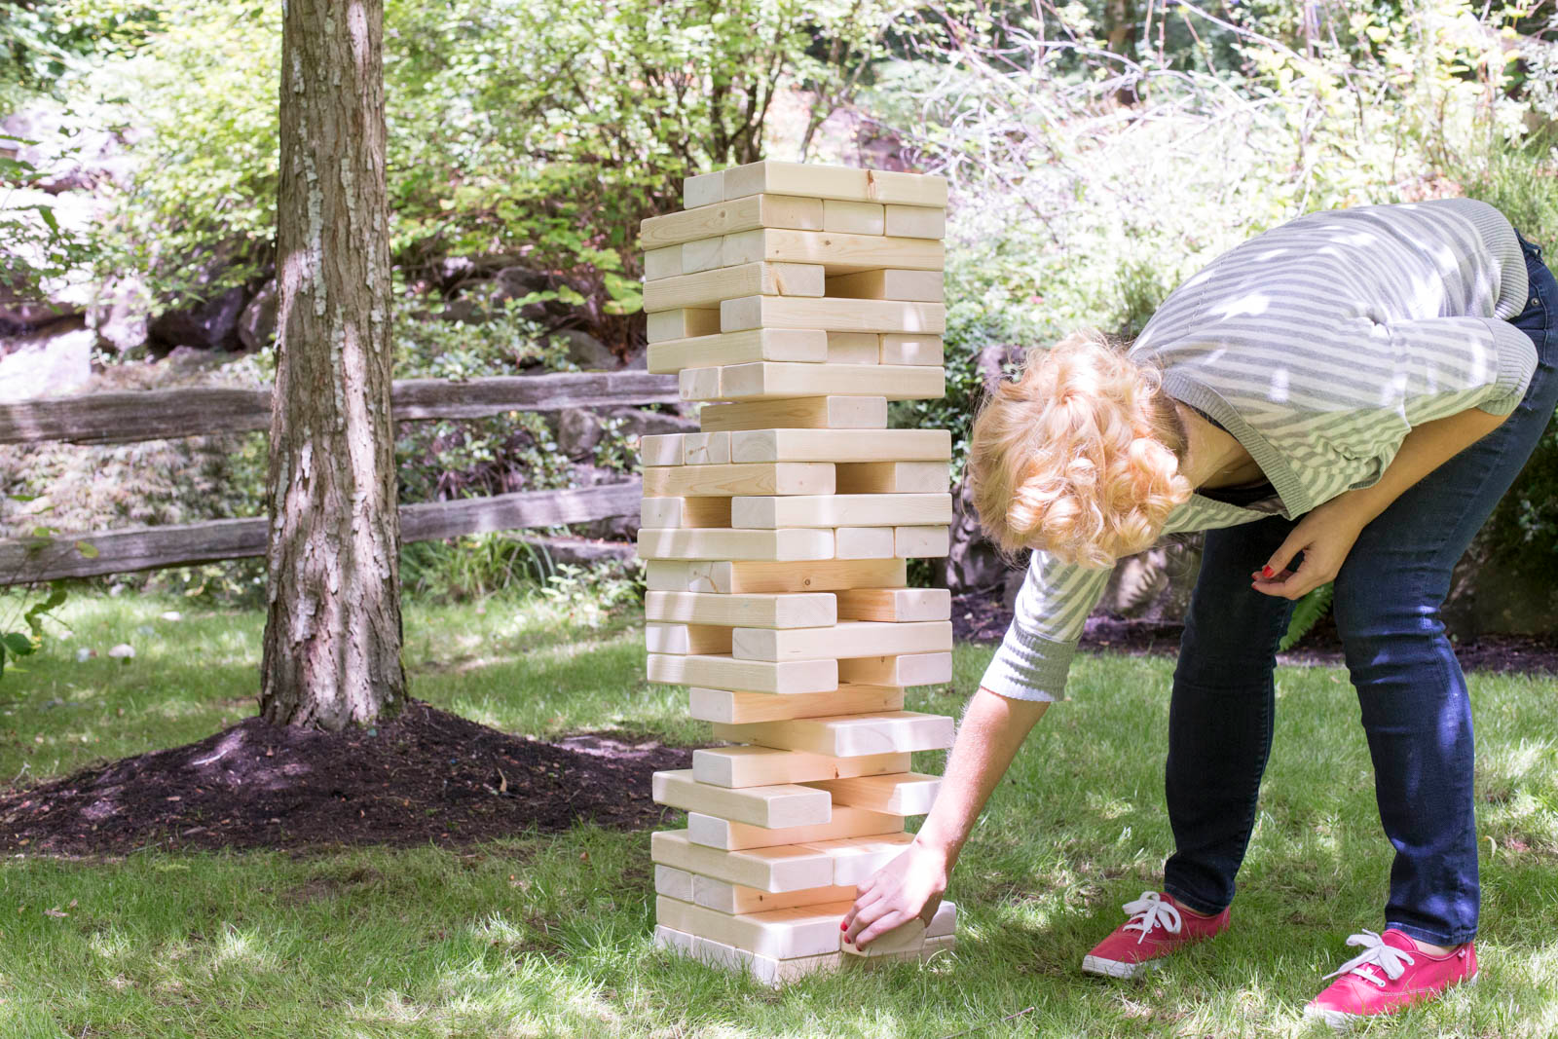
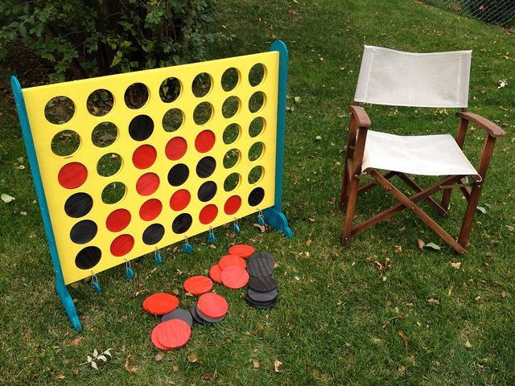
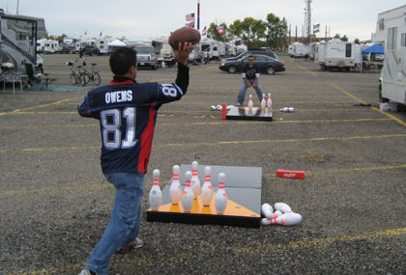
Games

Slide 5
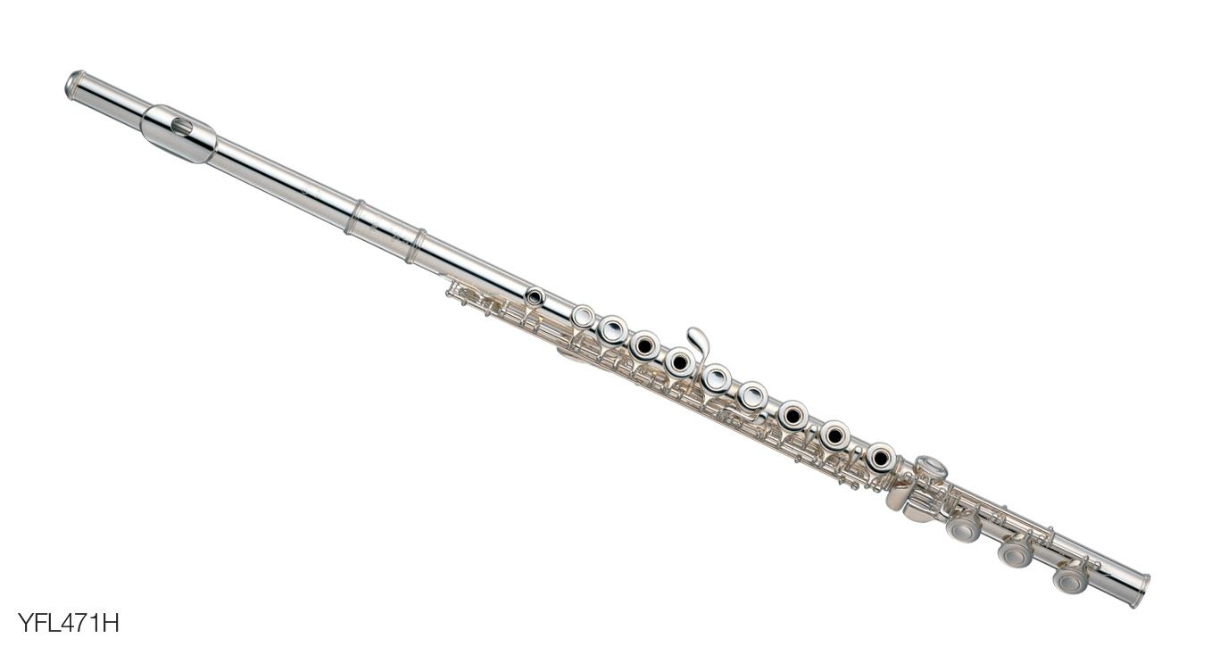
Used to practice
She ________________ (play) flute when she was younger.
Didn’t you ______________ (work) at the diner?
When did he ________________ (ride) a motorcycle?
I didn’t _________________ (go) to bed early.

Slide 6
Starting your story – model paragraph
My name is Toni Coral. I used to live in the United States, but now I don’t. I live in Windsor, Ontario in Canada. I moved to Canada in 2002. I live with my 15 year old son and husband.
Notes:
Mini paragraph to write. You will keep and build on to create your story.

Slide 7
The movies – George Lucas and Steven Spielberg
Two very famous American movie directors.
Longer article.
A little more challenging.
Preview vocabulary.
Notes:
Show clips

Slide 8
Vocabulary
unsuspecting
forces
galaxy
special effects
sequel
capture
imagination
sneak
big break
legends
ocean’s depths
moreover
notice
contributions
extraordinary
Notes:
Moreover – as a further matter, besides, in addition

