Slide 1
Tuesday, September 10, 2019
Welcome back!

Slide 2
Common greetings
What are some common greetings people in the U.S. use when they see each other?

Slide 3
Useful words/phrases for today
greeting
proficient
intermediate
beginner
average
icebreaker
address
envelope
seal
share
letter
closing
results
add
divide
Notes:
Don’t define now. Repeat together. Then individual repetition.

Slide 4
Test results for 23 students (PM class)
13 students took test 83
Average score: 210
No proficient score possible
5 students took test 185
Average score: 219
Proficient = 237

Slide 5
Test results for 23 students (AM class)
18 students took test 83
Average score: 210
No proficient score possible
6 students took test 185
Average score 219.5
Proficient = 237

Slide 6
CASAS
Three levels of the test:
  Beginner
  Intermediate (83/84)
  High Intermediate/Advanced (185/186)
Proficient is the goal.
  Competent, good, or skilled in doing or using something.
  Proficient = 237 on 185/186
Notes:
Click on Burlington to show students what I mean. Both intermediate and advanced.

Slide 7
Another icebreaker
We need to stand in a circle.
Every other person takes one step into the circle. Turn to face the outside of the circle.
Now we have two circles.
Twenty seconds to introduce yourself to the person in the other circle.

Slide 8
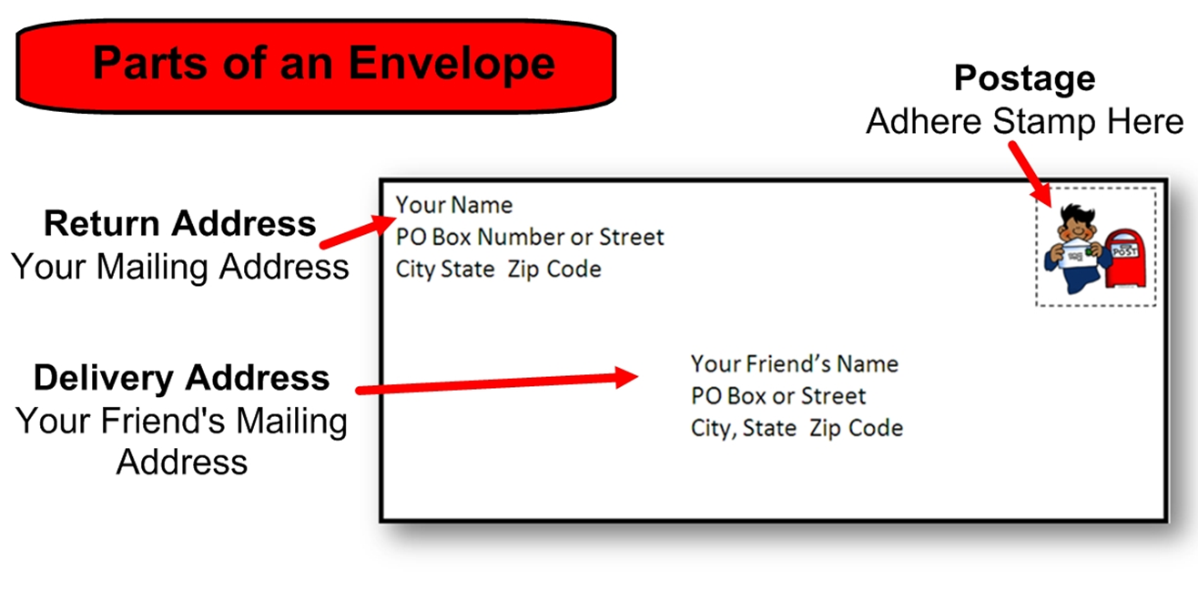

Slide 9
Letter to Self
Written in English, your native language, or a combination of the two.
I will mail it next summer.
Tell future “self” what you hope to accomplish this year.
Address the envelope to yourself.
Seal the envelope.

Slide 10
Review before we leave
greeting
proficient
intermediate
beginner
average
icebreaker
address
envelope
seal
share
letter
results
add
divide
Notes:
Ask for examples of: greeting, add, divide

