Slide 1
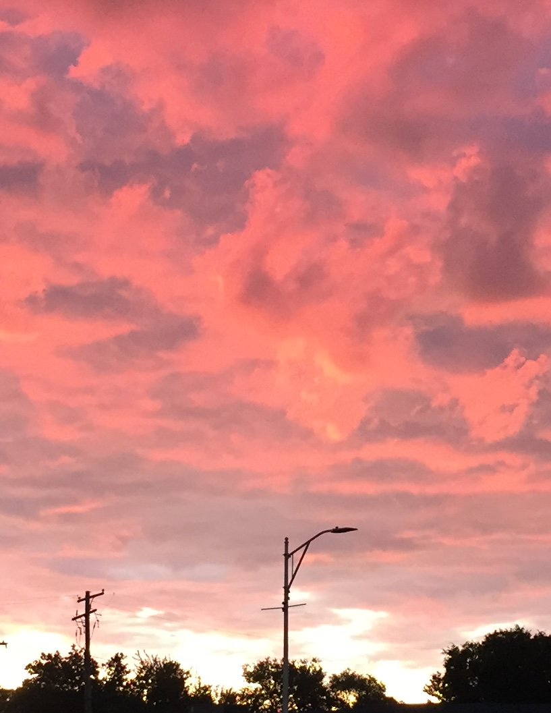
Tuesday, September 24, 2019
Good morning!

Slide 2
Unscramble the sentence
barks/ dog/ rarely/my
  My dog rarely barks
ice cream / we / sometimes / eat
  We sometimes eat ice cream.
  Sometimes, we eat ice cream.
  We eat ice cream, sometimes.

Slide 3
Unscramble the sentence game
Each table has been given words, not in order.
Your job, unscramble the words to create a sentence.
The sentence will not start with a capital letter. This is on purpose.

Slide 4
What are the sentences?
She never yells at her neighbors.
I always put grapes in my lunch.
The cat usually sleeps for hours.
Usually, the cat sleeps for hours.
The cat sleeps for hours, usually.
We rarely stay up late on weekdays.
You are often early for work.

Slide 5
Sentence puzzle – part 2
Write a sentence using an adverb of frequency.
Show me.
Write it on a sentence strip and cut it up.
Another group will have to solve your puzzle.

Slide 6
What would you do? A difficult decision.
Let’s look at the situation.
What would you do?
Create a dialogue between the worker and a family member.
Perform the dialogue (I’m not worried about spelling for this).

Slide 7
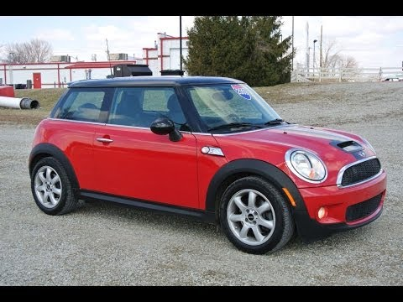
Past vs present
What are things you did in the past, but no longer do?
An old job? A old school?
Make a list of five different things you did in the past, but have stopped doing.
My list:
worked at hockey games
lived in Ferndale
taught high school
played volleyball
drove a Mini Cooper
Notes:
We have a lot of routines in our life, but our past helps to shape us. You had routines in the past, that have disappeared.

Slide 8
For tomorrow
Moving from the simple present to different ways to discuss the past.
Your list from today will be helpful.

