Slide 1
September 30, 2019
Notes:
How was your weekend?

Slide 2
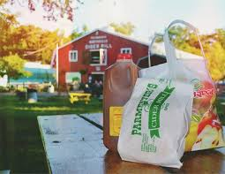
A delicious treat, if you’d like.
Cider
Drink it warm or cold.

Slide 3
Movies!
How to read a movie theater website.
The article about Lucas and Spielberg.
  Volunteers
  Comprehension
Burlington
Notes:
Lesson 34 – level c

Slide 4
Stores
Brainstorm all the stores you can think of.
What do those stores sell?

