Slide 1
Tuesday, October 1, 2019
Happy New Month!!

Slide 2
Reminders
Morning class – field trip tomorrow. Leaving here at 9:45
Bring an umbrella
PM Class – field trip on October 7.
Conversation class starts on Friday ☺
  Flyer

Slide 3
Vocabulary for the day
retail
goods
services
laundromat
drug store
pharmacy
hardware store
grocery store
post office
office supply store
party store
furniture store
jewelry store
department store
hotel
bank
gas station
dry cleaners
hair salon
auto supply store

Slide 4
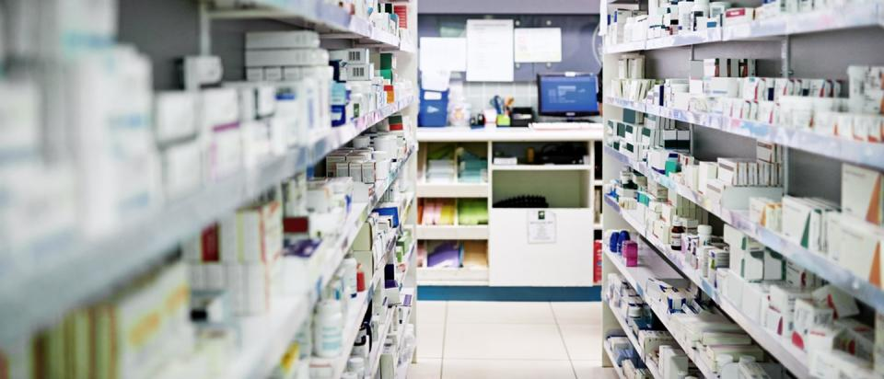
What kind of store?

Slide 5
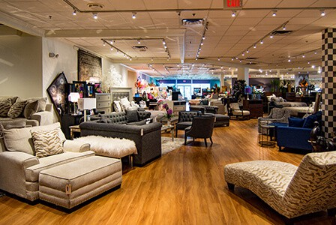
What kind of store?

Slide 6
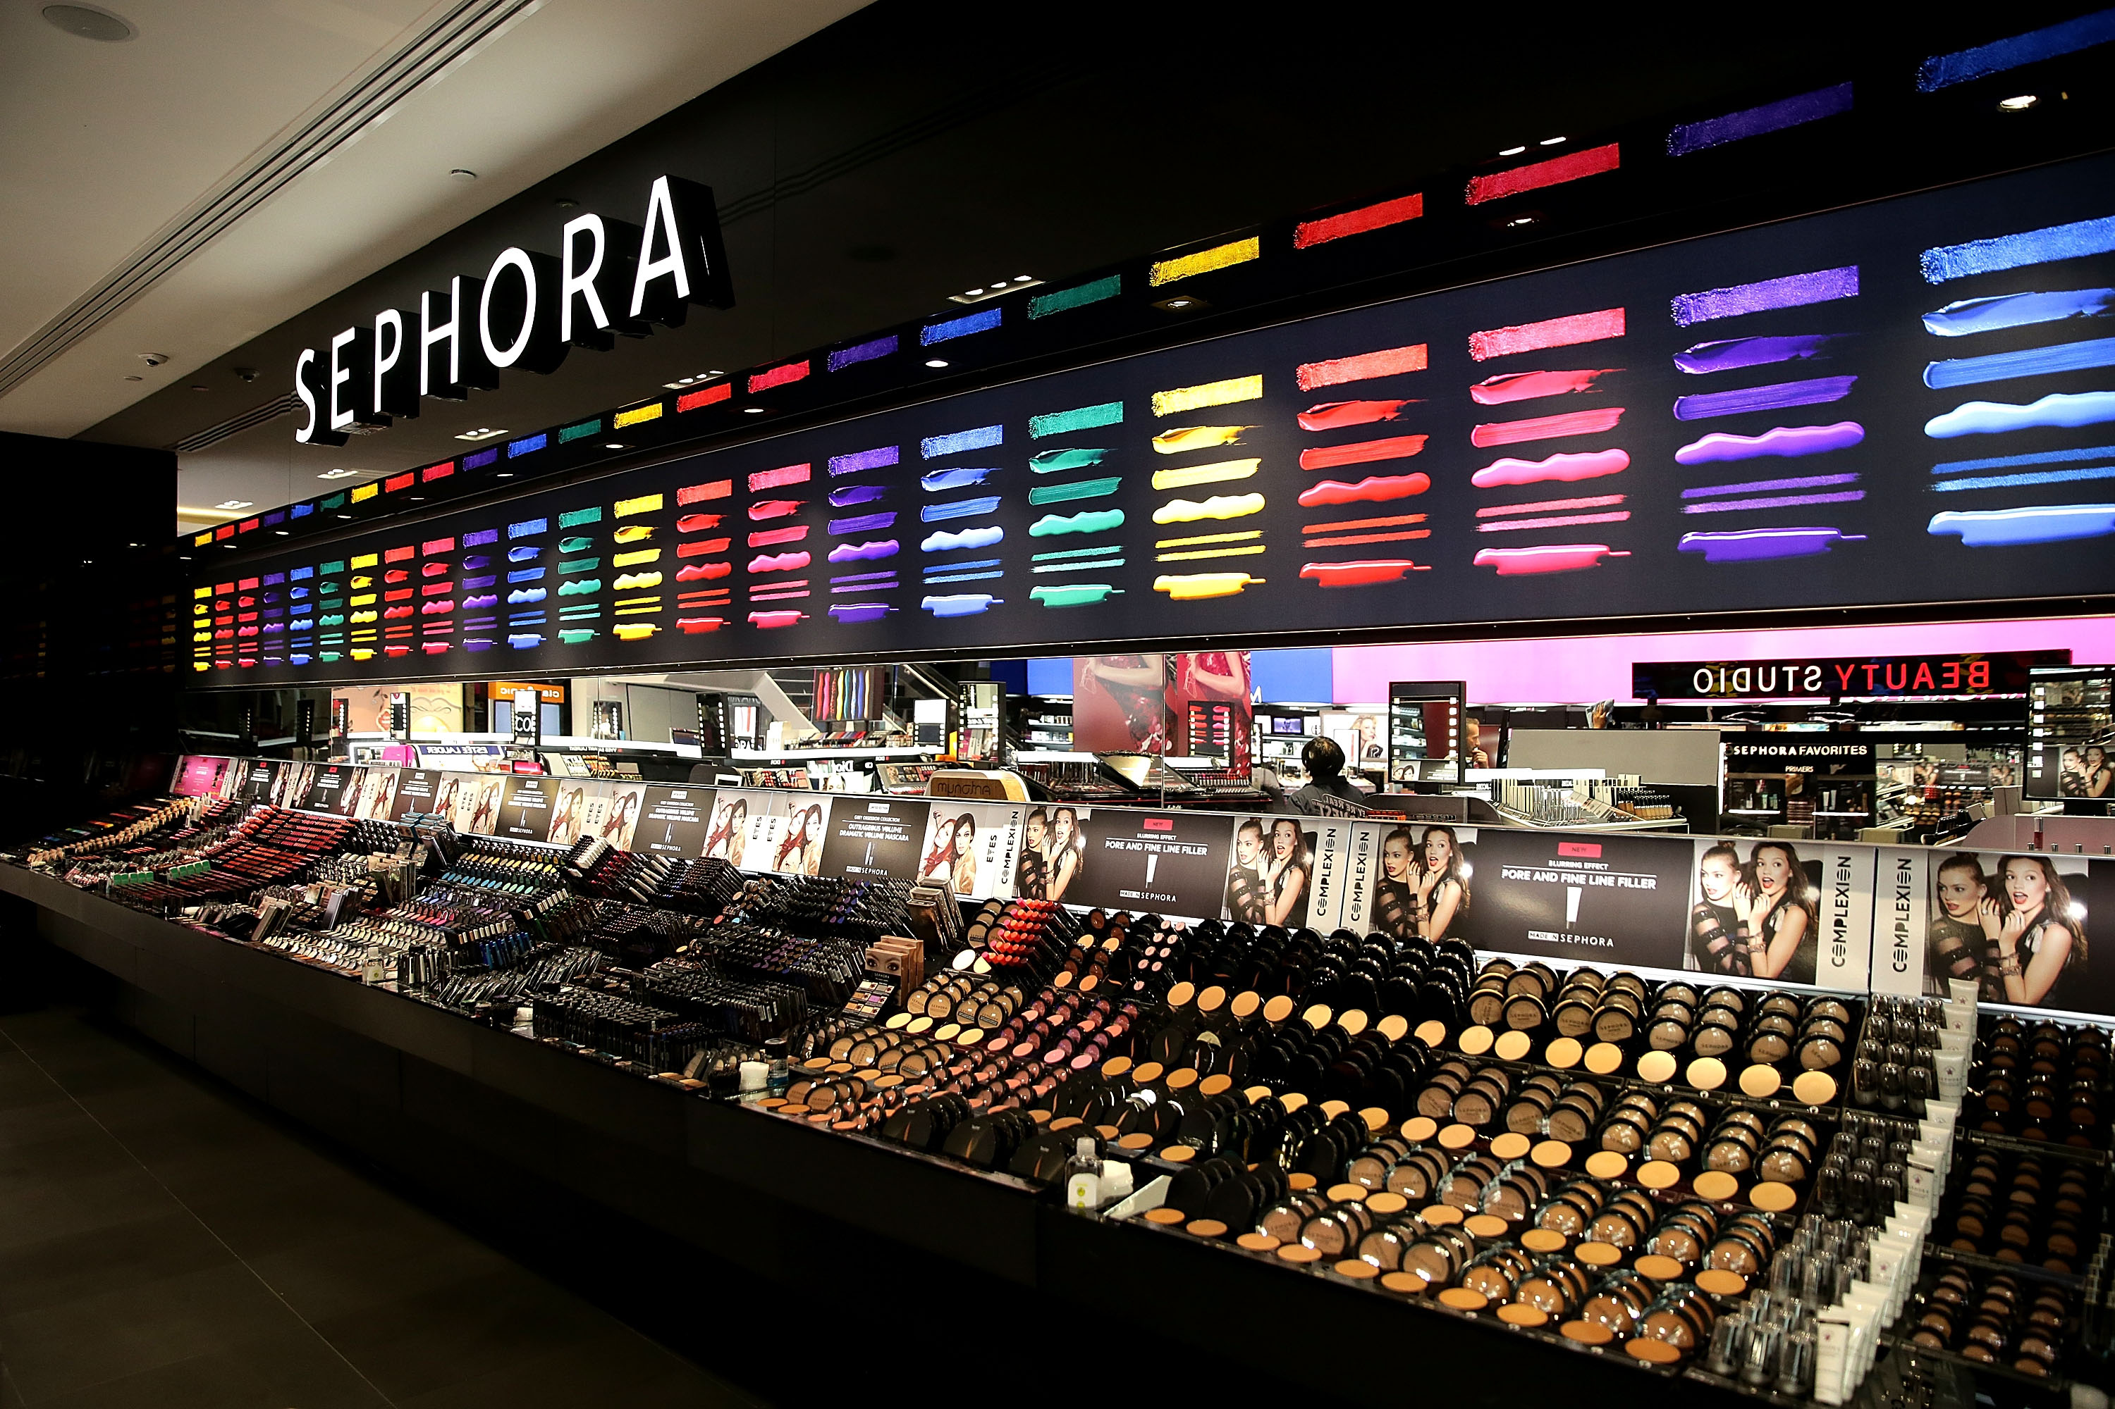
What kind of store?

Slide 7
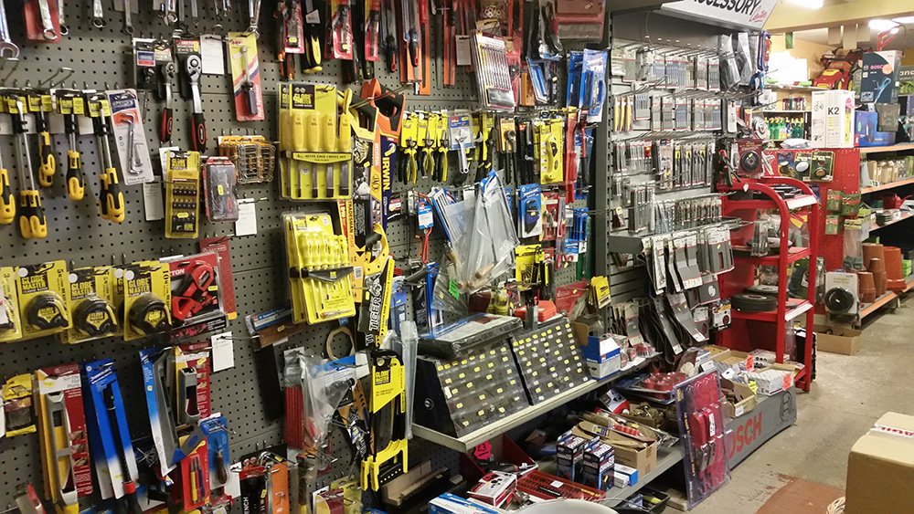
What kind of store?

Slide 8
Questions
What is the difference between a retail business and a service business?
Examples of services?

Slide 9
To get something done
Subject + get + object + past participle
Past participle is usually the –ed form of the verb
  Chart
Also used to create perfect tenses of verbs.
Booklet – page 22
Notes:
Irregular verb chart. Five verbs we want the definition of.

Slide 10
Can + base form of the verb
I can buy apples at the grocery store.
We can buy a table at the furniture store.

Slide 11
Combination
She can get her prescription at the drug store.
They can get some money from the ATM.
He can get a haircut tomorrow.
Notes:
Informal and common way for Americans to speak

Slide 12
Exit cards questions
What can you get at a jewelry store?
What can you get at the hair salon?
What can you get at the department store?
What can you get at an office supply store?
What can you get at an auto supply store?

